Slide 1
CSE Workshop
SQL and NoSQL Databases Intro

Slide 2
Speakers:
Kavyansh Tiwari
Shubham Kumar Agrawal
1.Amruta Gajanan Bhat
2.Rupesh Chowdary Peddineni
Event Managers:
3

Slide 3

Resources
Github Link: https://github.com/kavyansht21/cse_workshop_dbs
3

Slide 4
Rules and Flow
Be interactive
Materials via Github
Hands-on
Ask questions anytime
3

Slide 5
What is a Database?
An organized collection of structured and unstructured information, or data, typically stored electronically.
Think of it as a powerful, digital filing cabinet.
Managed by a Database Management System (DBMS).
Why? To store, retrieve, update, and manage data efficiently.
4

Slide 6
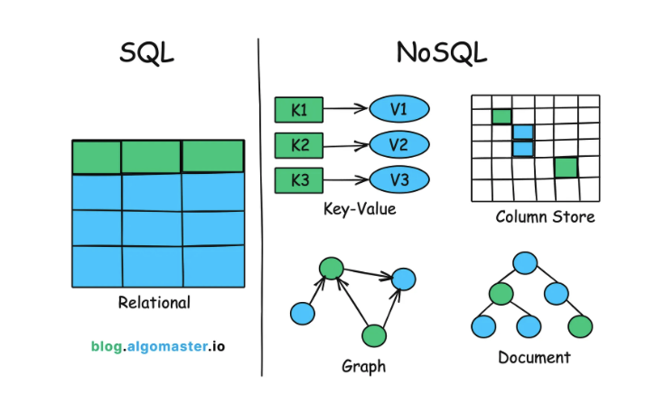
The Two Main Flavors
SQL | NoSQL
Relational database | Non relational database
Stands for structured query language | Stands for Not only SQL
Data stored in tables with rows and columns | Data is stored in flexible models(docuents, key:value)
Analogy: Highly organized Excel sheet | Analogy: A folder with different types of documents
5

Slide 7
Deep Dive: SQL
Structure: Pre-defined schema (a blueprint).
Data Model: Tables with rows and columns.
Language: SQL (e.g., SELECT * FROM Users;)
Consistency: Follows ACID properties to guarantee transactions.
Examples: MySQL, PostgreSQL, Oracle.
6

Slide 8
ACID properties
A: Atomicity
C: Consistency
I : Isolation
D: Durability
6

Slide 9
Hands-On: Your First SQL Query
Scenario: A Students table with columns: StudentID, FirstName, LastName, Major.
Your Task: Write a SQL query to find all students whose major is 'Computer Science'.
Example Answer: SELECT * FROM Students WHERE Major = 'Computer Science';
6

Slide 10
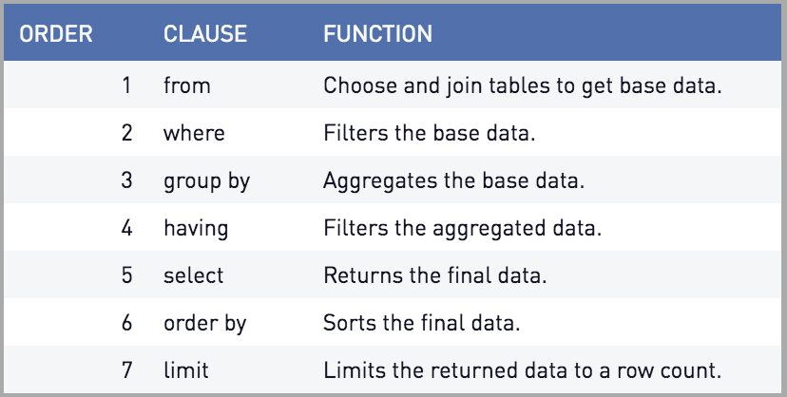
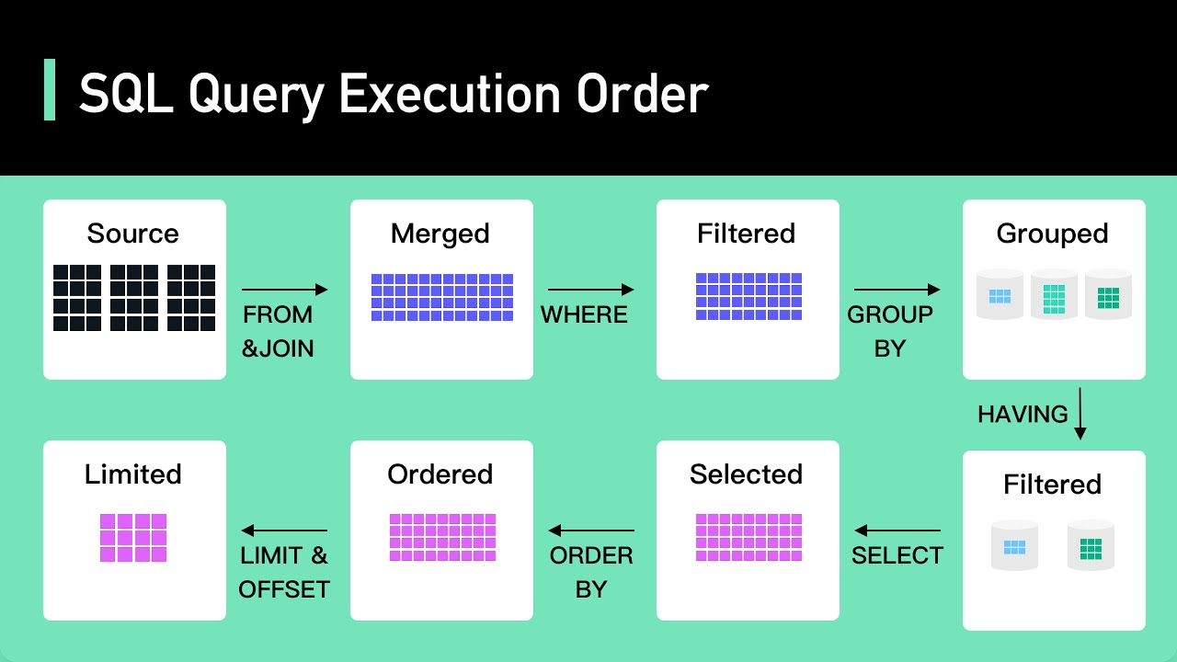
Query execution order
6

Slide 11
Hands on

Slide 12
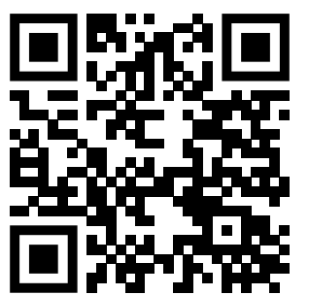
Quiz 1
https://www.menti.com/alkq6znxgzqt

Slide 13
JOINS
A JOIN clause is used to combine rows from two or more tables based on a related column between them. It's how you stitch together related information that's stored in different places.
6

Slide 14
Types of Joins
INNER JOIN: Returns records that have matching values in both tables. This is the most common type of join.
Analogy: Finding people who are on both the basketball team and the chess club.
LEFT JOIN: Returns all records from the left table, and the matched records from the right table. If there's no match, the result is NULL from the right side.
Analogy: Getting a list of all basketball players and, if they're also in the chess club, their chess club ID.
RIGHT JOIN: The opposite of a LEFT JOIN. It returns all records from the right table and the matched records from the left table.
FULL OUTER JOIN: Returns all records when there is a match in either the left or right table. It essentially combines the results of both LEFT and RIGHT joins.
6

Slide 15
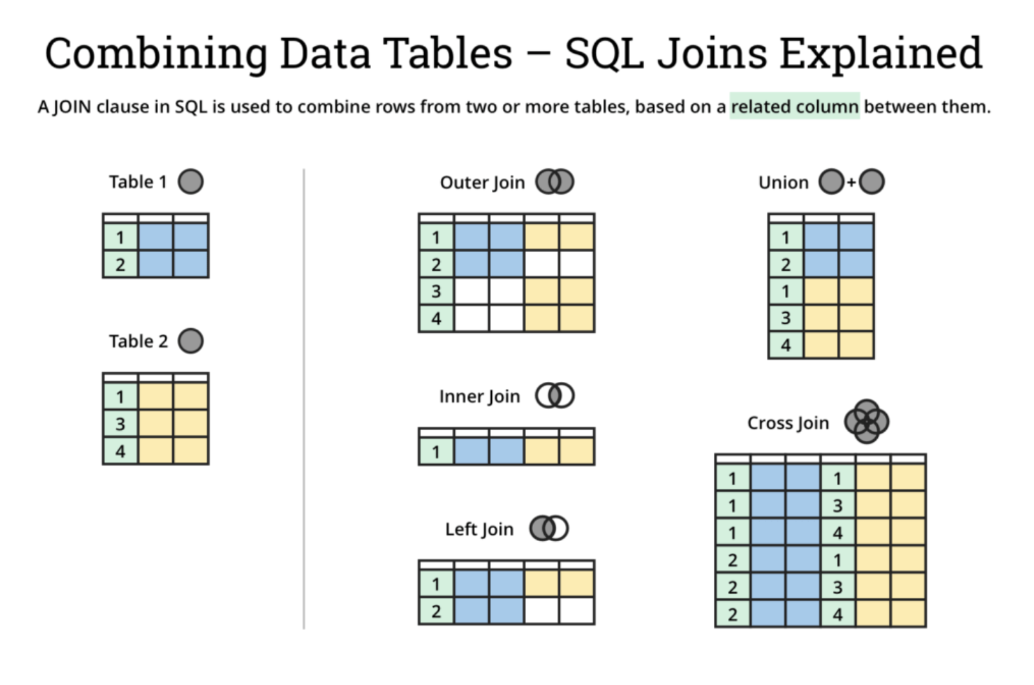
Types of Joins
6
Reference

Slide 16
Deep Dive: NoSQL
Structure: Dynamic or no schema.
Data Models:
- Document (JSON)
- Key-Value
- Graph
Consistency: Follows the BASE model (eventual consistency).
Scalability: Scales horizontally (add more machines).
Examples: MongoDB, Redis, Cassandra.
6

Slide 17
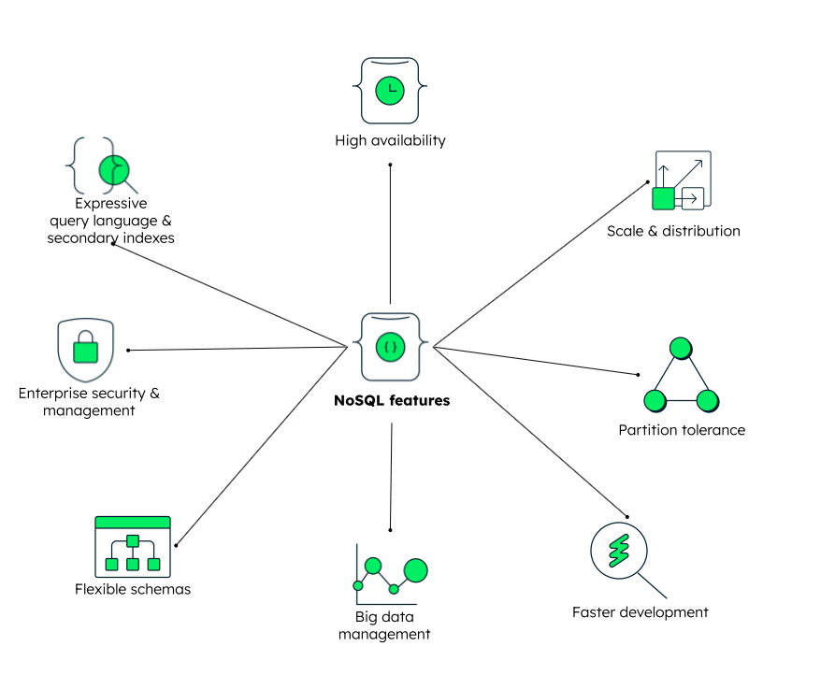
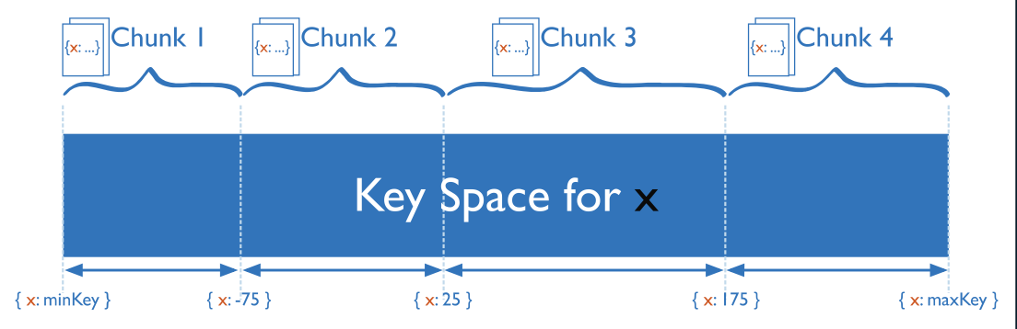
WHY NoSQL ?
Data Volume in 2025: 150+ Zettabyte (1 Zettabyte = 1B Terabytes)
Vertical Scaling vs horizontal scaling
At a high level
Distributed computing
Scaling
Flexible schemas and rich query language
Ease of use for developers
Partition tolerance
High availability
6

Slide 18
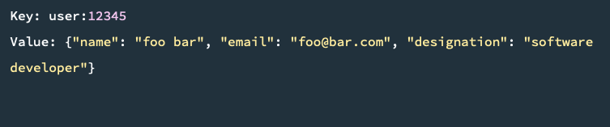
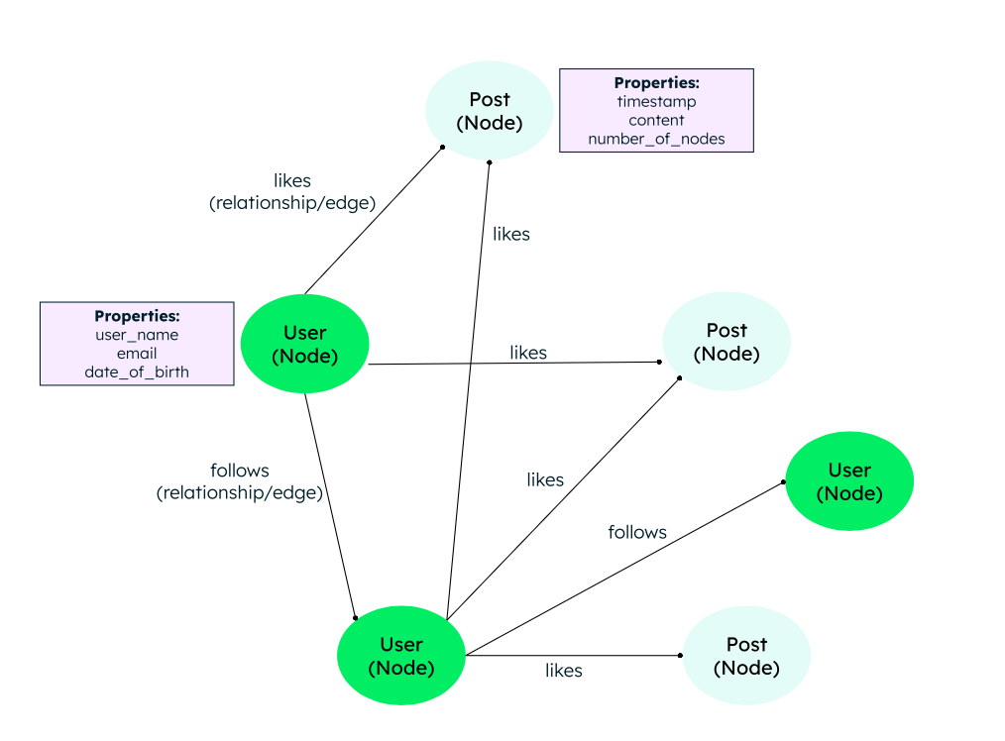
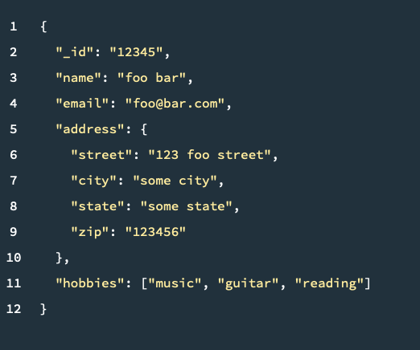
How a NoSQL data looks like?
Key-value database
Graph database
Document database
6

Slide 19
Hands-On:
6

Slide 20
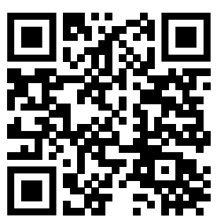
Quiz 2
https://www.menti.com/alituhyv25oe

Slide 21
Head-to-Head Comparison
Metric | SQL | NoSQL
Feature | Relational | Non Relational
Schema | Fixed, Pre Defined | Dynamic
Scalability | Vertically stacked and limited | Both Vertically and Horizontally scaled
Consistency | Strong (ACID) | Eventual (BASE)
Best For | Data Integrity | Big Unstructured Data
6

Slide 22
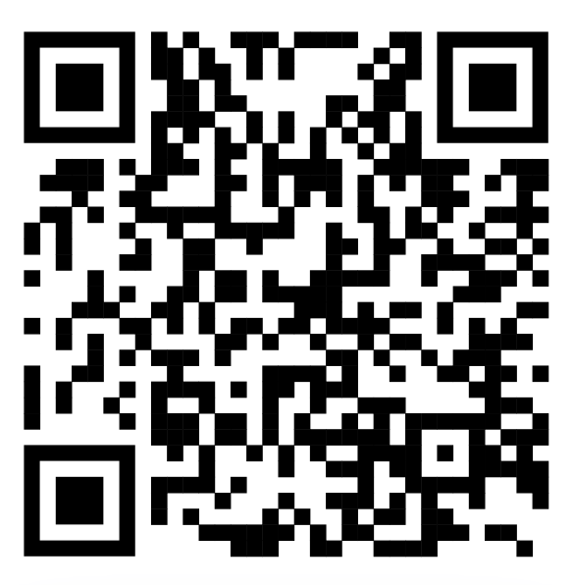
Quiz 3
https://www.menti.com/alkq6znxgzqt
6

Slide 23
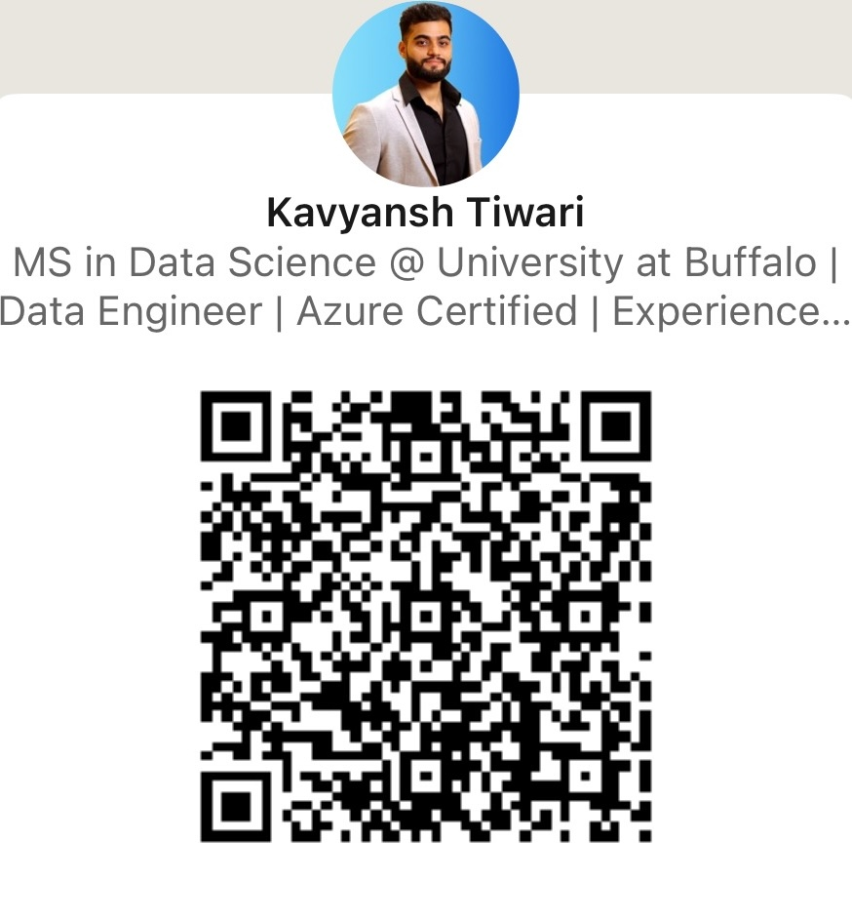
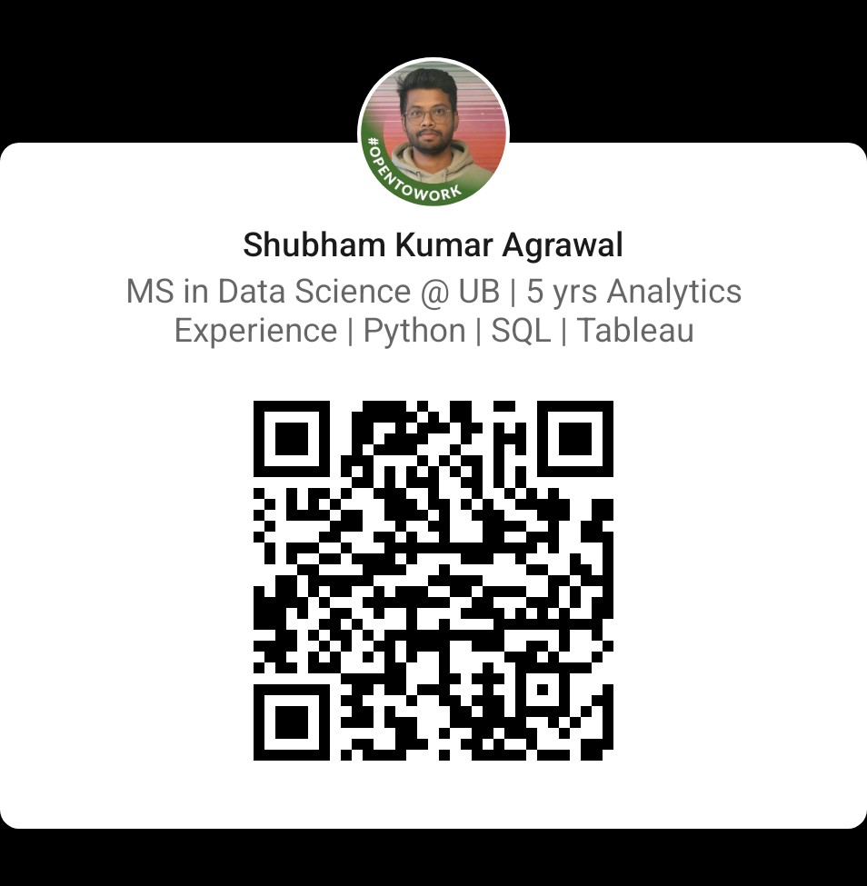
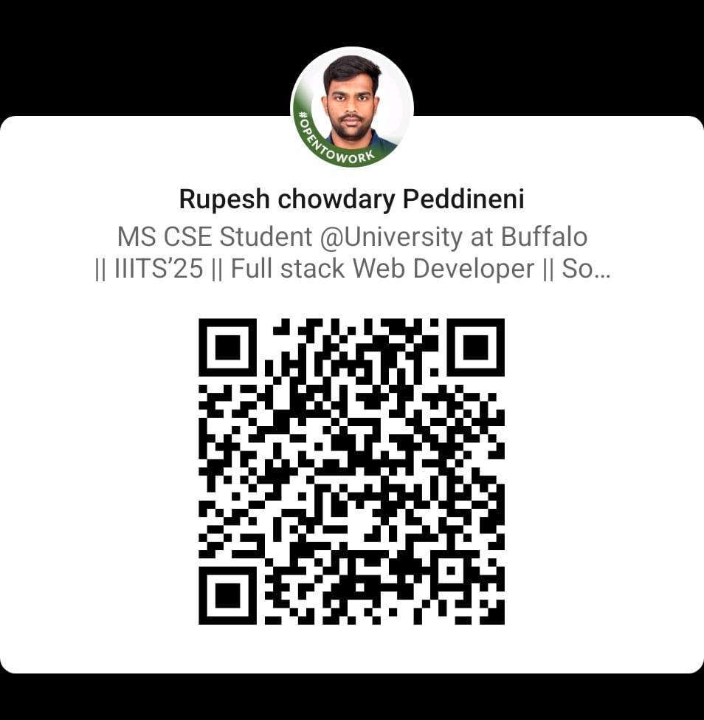

Thank you for joining the session !!
6

Slide 24
Certificate

Slide 25
Q&A

Slide 26
References:
NoSQL:
https://www.mongodb.com/resources/basics/databases/nosql-explained
https://www.mongodb.com/docs/manual/tutorial/query-documents/
https://www.mongodb.com/docs/manual/reference/mql/query-predicates/

